Slide 1

Subject Code: SCS1301 Subject Name: Operating System UNIT III Faculty Name: Dr. P. AJITHA

Slide 2
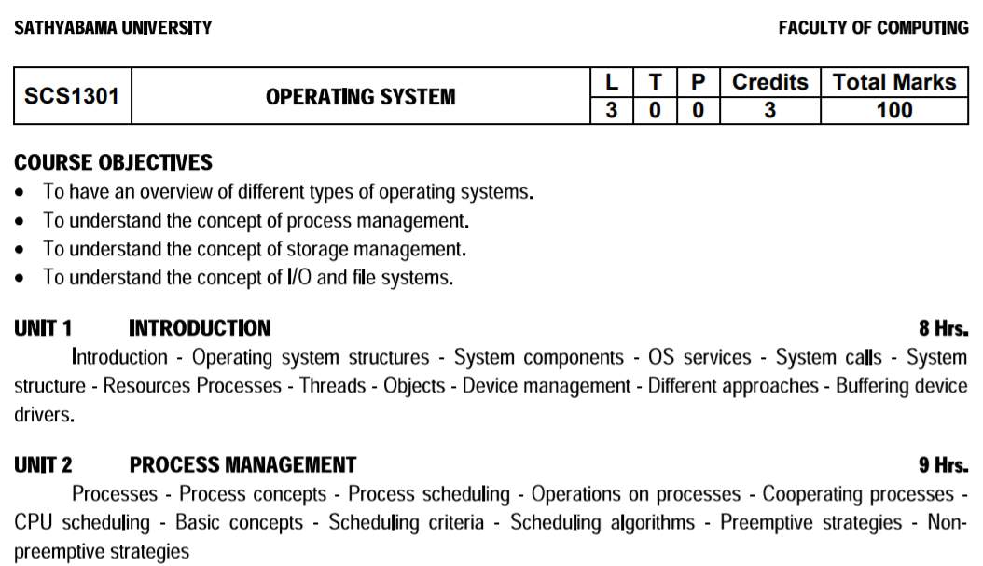

Slide 3
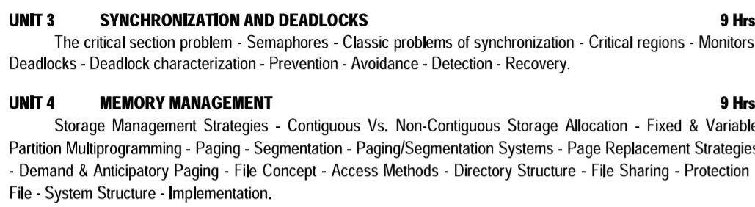

Slide 4
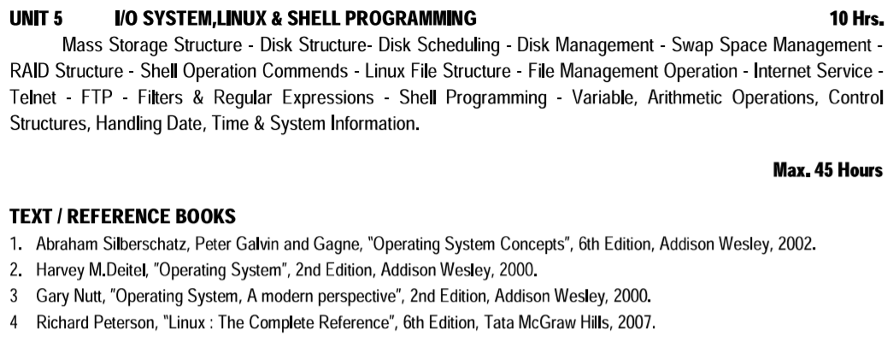

Slide 5
Course Outcome
Comprehend knowledge about Operating system components and services.
Apply knowledge of process scheduling algorithms for a given context
Analyze process synchronization and deadlock Conditions
Construct the process of Mapping logical address to physical address
Design appropriate strategies for Paging and Segmentation
Develop Real Time Applications Based on Linux Shell Programming.

Slide 6
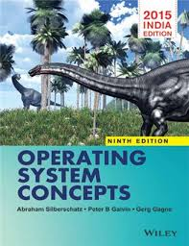
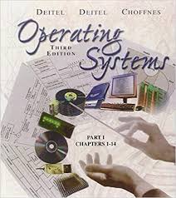

Recommended Books:

Slide 7
Roadmap to UNIT IV
Page Replacement Strategies -
Demand & Anticipatory Paging - File Concept - Access Methods - Directory Structure - File Sharing - Protection - File -
System Structure - Implementation.

Slide 8
Virtual Memory:
Virtual memory is a technique that allows the execution of processes that may not be completely in memory.
Something which appear to be present actually it is not.
It gives illusion to user.
The size of the program can be larger than the capacity of main memory.
A programmer can write a program which requires more memory than the capacity of the main memory. Such a program can be executed using virtual memory technique.
Eg. 16GB program can be executed with 4GB Main memory
Only part of the program need to be in memory for execution.
In many cases, in the course of execution of a program, some part of the program may never be executed. E.g., code in programs that handle unusual error conditions will not be executed (needed) most of the time.
And even if the whole program is needed, it may not all be needed at the same time.

Slide 9
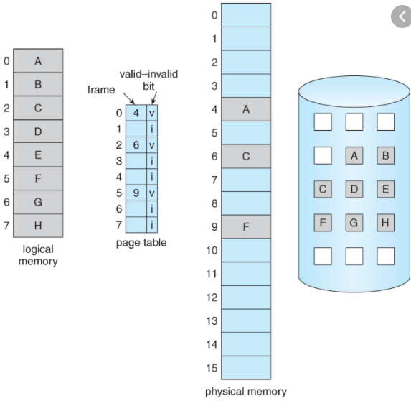
Virtual Memory:

Slide 10
Advantage of Virtual Memory:
Users would be able to write programs whose logical address space is greater than the physical address space.
More programs could be run at the same time thus increasing the degree of multiprogramming.
Less I/O would be needed to load or swap each user program into memory, so each program would run faster.
Virtual memory can be implemented via:
Demand paging
Demand segmentation

Slide 11
Demand Paging:
The basic idea behind demand paging is that when a process is swapped in, its pages are not swapped in all at once.
Rather they are swapped in only when the process needs them. ( on demand. )
This is termed a lazy swapper, although a pager is a more accurate term.

Slide 12
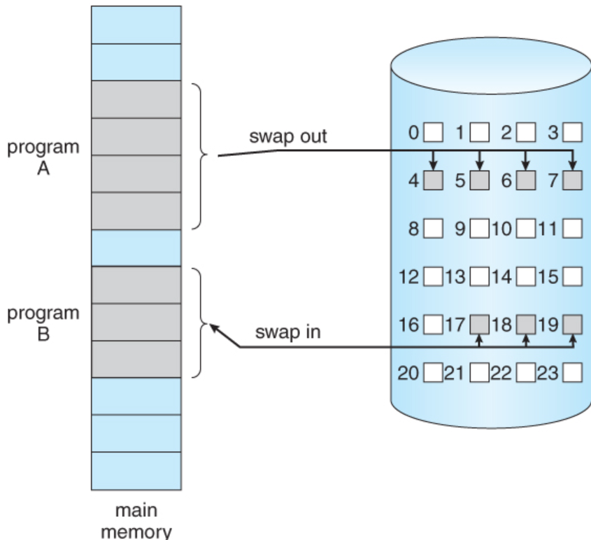
Transfer of a paged memory to contiguous disk Space

Slide 13
Demand Paging:
The basic idea behind paging is that when a process is swapped in, the pager only loads into memory those pages that it expects the process to need ( right away. )
Pages that are not loaded into memory are marked as invalid in the page table, using the invalid bit. ( The rest of the page table entry may either be blank or contain information about where to find the swapped-out page on the hard drive. )
If the process only ever accesses pages that are loaded in memory ( memory resident pages ), then the process runs exactly as if all the pages were loaded in to memory.

Slide 14
Page table when some pages are not in main memory.

Slide 15
Steps to Handle Page Fault:
If a page is needed that was not originally loaded up, then a page fault trap is generated, which must be handled in a series of steps
We check an internal table (usually kept with the PCB) for this process, to determine
whether the reference was a valid or invalid memory access.
If the reference was invalid, we terminate the process. Otherwise, we have not brought
in that page into the memory.
We find a free frame.
We schedule a disk operation to read the desired page into the newly allocated frame.
When the disk read is complete, we modify the internal table kept with the process and
the page table to indicate that the page is now in memory.
We restart the instruction that was interrupted by the trap. That process can now access
the page as though it had been always in memory.

Slide 16
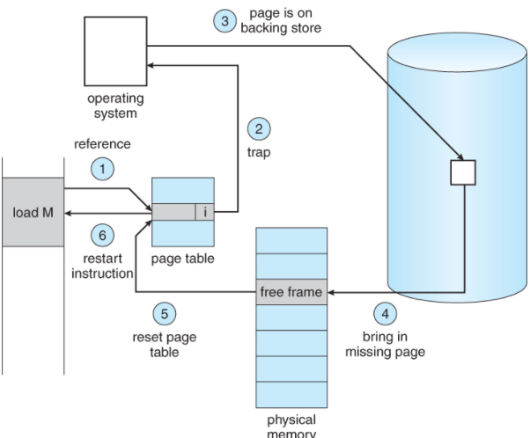
Steps to Handle Page Fault:

Slide 17
Page Replacement
The basic approach of page replacement is:
If no frame is free, we find one which is currently being used and free it.
We can free a frame by writing its contents to swap space, and changing
the page table and all other tables.
The freed frame can now be used to hold the page for which the process faulted.

Slide 18
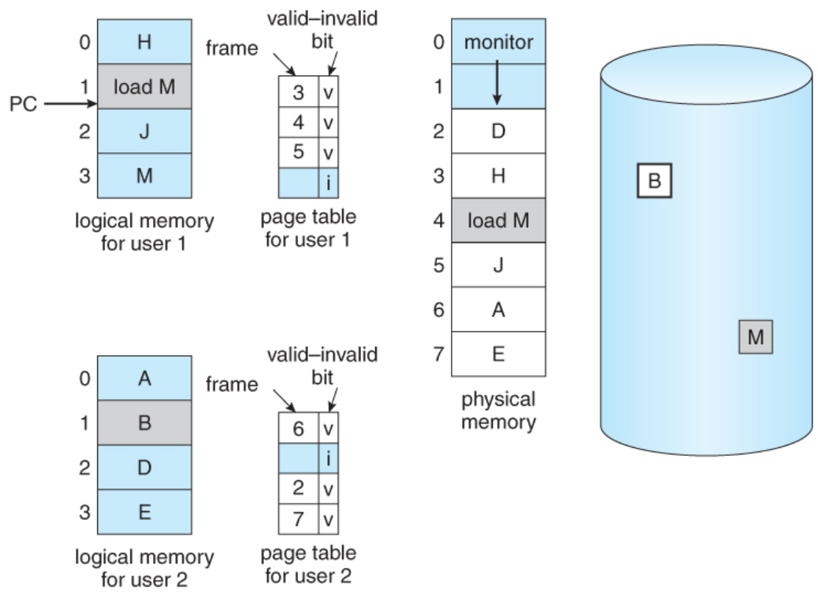
Need for Page Replacement

Slide 19
Page Replacement
Find the location of the desired page on the disk.
Find a free frame:
a. If there is a free frame, use it.
b. If there is no free frame, use a page-replacement algorithm to select
c. Write the victim frame to the disk; change the page and frame tables accordingly.
3. Read the desired page into the newly freed frame; change the page and frame tables.
4. Restart the user process.

Slide 20
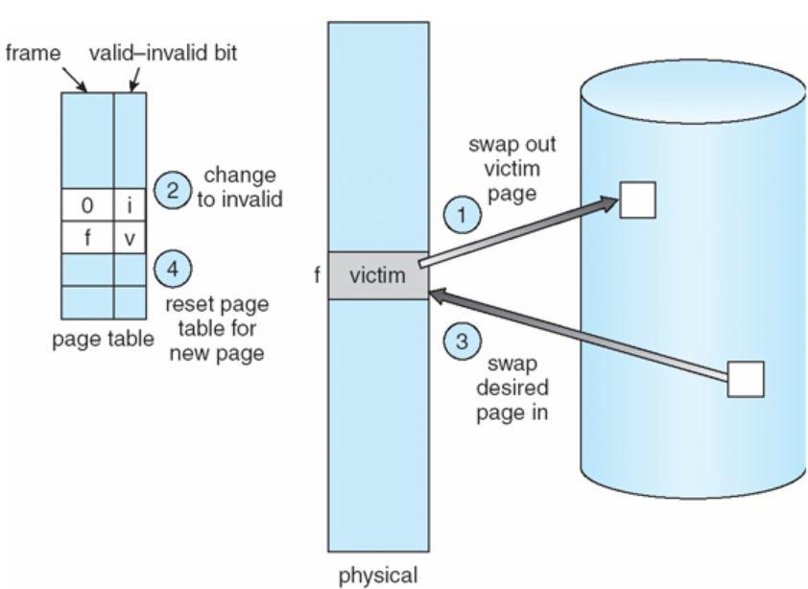
Page Replacement

Slide 21
Page Replacement
If no frames are free, two page transfers (one out and one in) are required.
This effectively doubles the page-fault service time and will increase the effective access time accordingly.
This overhead can be reduced by the use of a modify (dirty) bit.
Each page may have a modify bit associated with it in the hardware.
The modify bit for a page is set by the hardware whenever any word or bytes in the page is modified.
When we select a page for replacement, we examine it’s modify bit.
If it is set, it means the page has been modified since it was read from the disk.
In this case, we must write that page to the disk.
If the modify bit is not set, the copy of this page on the disk has not been overwritten (by some other page, for example), we can avoid writing the memory page to the disk.

Slide 22
PAGE REPLACEMENT ALGORITHMS
There are many page-replacement algorithms.
We select a particular replacement algorithm based on the one with the lowest page-fault rate.
An algorithm is evaluated by running it on a particular string of memory references (called a reference string) and computing the number of page-faults.
Reference strings are generated artificially (by a random-number generator, for example) or by tracing a given system and recording the address of each memory reference.
For simplicity we consider only the page number of each address.
And if we have a reference to page p, then any immediately following references to page p will never cause a page fault.

Slide 23
Page Replacement
E.g., if we trace a particular process, we might record the following address sequence
0100,0432,0101,0612,0102,0103,0104,0101,0611,0102,0103, 0104,0101,0610,0102,0103,0104,0101,0609,0102,0105
which, at 100 bytes per page, is reduced to the following reference string
1, 4, 1, 6, 1, 6, 1, 6, 1, 6, 1

Slide 24
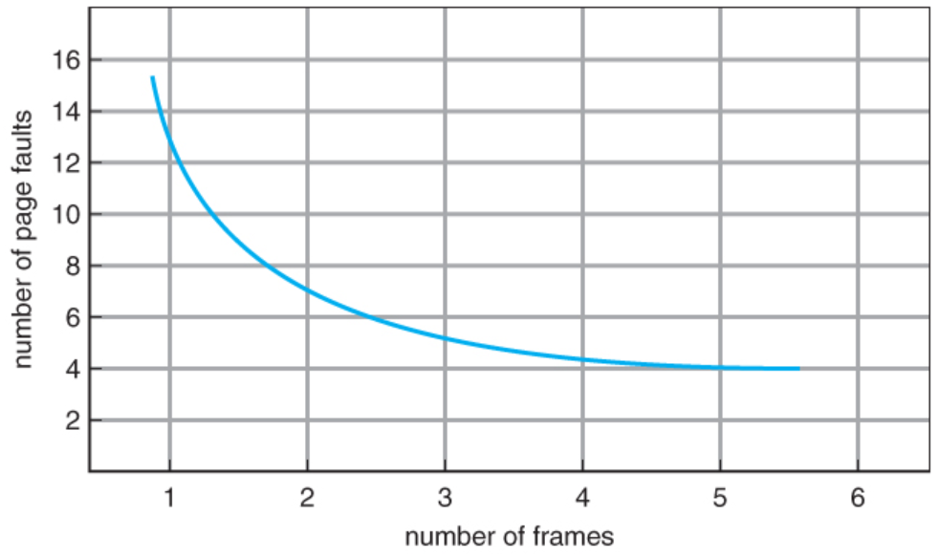
Page Replacement

Slide 25
FIFO Page Replacement Algorithm
When a page must be replaced, the oldest page in the memory is chosen.
This can be implemented by using a FIFO queue.
The queue holds all the pages in the memory.
We replace the page at the head of the queue.
When a page is brought into memory, we insert it at the tail of the queue. Reference string
7 0 1 2 0 3 0 4 2 3 0 3 2 1 2 0 1 7 0 1
With number of frames = 3, the number of page faults is 15.

Slide 26
FIFO Page Replacement Algorithm

Slide 27
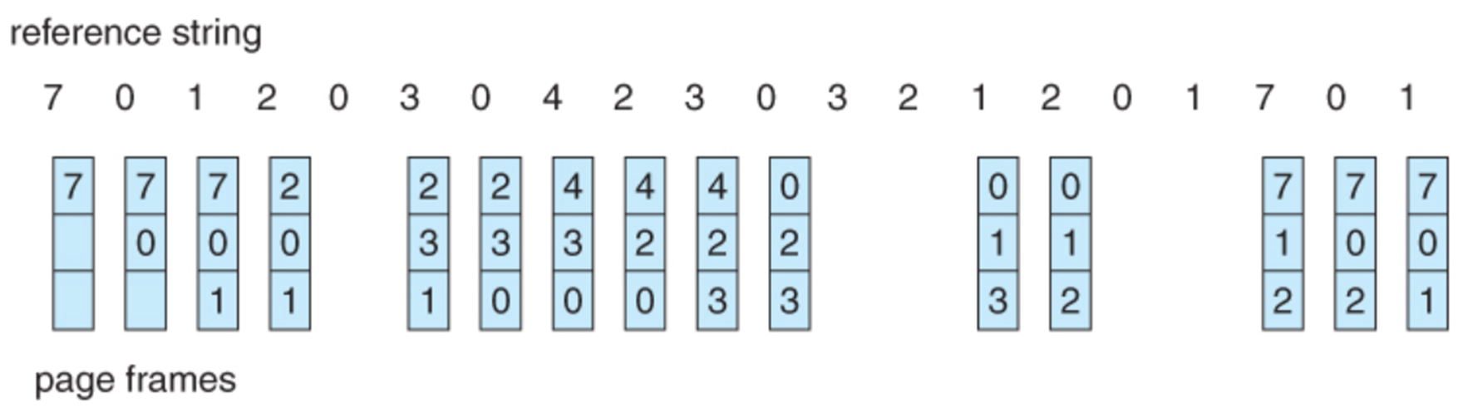
FIFO Page Replacement Algorithm

Slide 28
FIFO Page Replacement Algorithm

Slide 29
FIFO Page Replacement Algorithm
The page-fault rate is expected to decrease as the number of allocated frames increase.
This may not always be the case.
If the page-fault rate increases as the number of allocated frames increase, we say that Belady’s anomaly has occurred.
Such a case can be seen by trying out the reference string using FIFO algorithm:
1 2 3 4 1 2 5 1 2 3 4 5
You will notice that the number of page faults for four frames is greater than that for three frames.
Disadvantages:
It can suffer from Belady’s anomaly.

Slide 30
Optimal Page Replacement Algorithm
Replace the page that will not be used for the longest period of time.
This algorithm has the lowest page-fault rate of all algorithms.
It will never suffer from Belady’s anomaly.

Slide 31
Optimal Algorithm

Slide 32
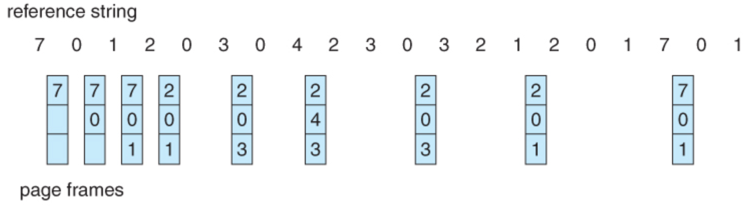
Optimal Page Replacement Algorithm

Slide 33
Disadvantage:
Difficult to implement since future knowledge of the reference string is required.
Because of the above disadvantage, this algorithm is mainly used for comparison studies, i.e., to see whether some algorithm can perform as good as the optimal algorithm.

Slide 34
LRU (Least Recently Used) Algorithm:
Replace the page that has not been used for the longest period of time.
For the same test set, the number of page faults produced by this algorithm is 12.
This algorithm is considered to be quite good and is often used.
It can be implemented in two ways:
Counters:
We associate with each page-table entry a time-of-use field, and add to the CPU a logical clock or counter.
The clock is incremented for every memory reference.
Whenever a reference to a page is made, the contents of the clock register are copied to
the time-of-use field in the page table for that page.
We replace the page with the smallest value.

Slide 35
LRU (Least Recently Used) Algorithm:
Replace the page that has not been used for the longest period of time.
For the same test set, the number of page faults produced by this algorithm is 12.
This algorithm is considered to be quite good and is often used.
It can be implemented in two ways:
Counters:
We associate with each page-table entry a time-of-use field, and add to the CPU a logical clock or counter.
The clock is incremented for every memory reference.
Whenever a reference to a page is made, the contents of the clock register are copied to the time-of-use field in the page table for that page.
We replace the page with the smallest value.

Slide 36
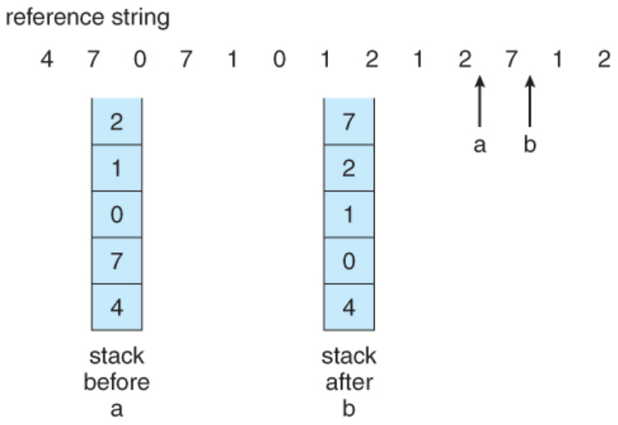
Stack:
Another way is to keep a stack of page numbers.
Whenever a page is referenced, it is removed from the stack and put on the top.
In this way, the top of the stack is always the most recently used page and the bottom is the least recently used (LRU) page.

Slide 37
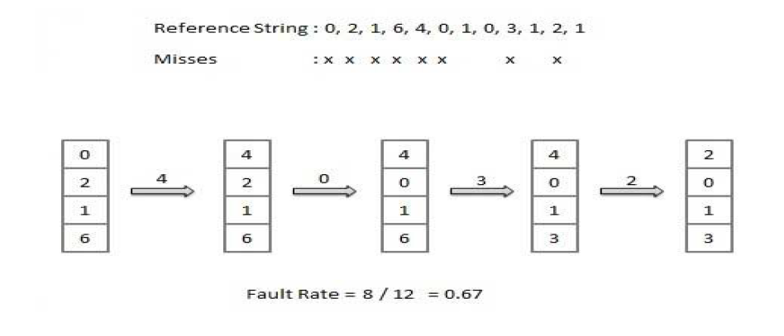
LRU

Slide 38
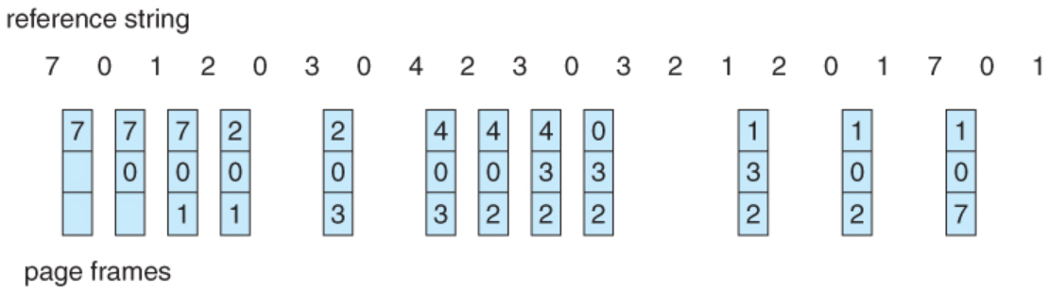
LRU (Least Recently Used) Algorithm:

Slide 39
LRU (Least Recently Used) Approximation Algorithm:
Second Chance Algorithm
The second chance algorithm is essentially a FIFO, except the reference bit is used to give pages a second chance at staying in the page table. When a page must be replaced, the page table is scanned in a FIFO ( circular queue ) manner.
If a page is found with its reference bit not set, then that page is selected as the next victim.
If, however, the next page in the FIFO does have its reference bit set, then it is given a second chance:
The reference bit is cleared, and the FIFO search continues.
If some other page is found that did not have its reference bit set, then that page will be selected as the victim, and this page ( the one being given the second chance ) will be allowed to stay in the page table.
If , however, there are no other pages that do not have their reference bit set, then this page will be selected as the victim when the FIFO search circles back around to this page on the second pass.

Slide 40
Second Chance Algorithm

Slide 41
Enhanced Second Chance Algorithm
The enhanced second chance algorithm looks at the reference bit and the modify bit ( dirty bit ) as an ordered page, and classifies pages into one of four classes:
( 0, 0 ) - Neither recently used nor modified.
( 0, 1 ) - Not recently used, but modified.
( 1, 0 ) - Recently used, but clean.
( 1, 1 ) - Recently used and modified.
This algorithm searches the page table in a circular fashion ( in as many as four passes ), looking for the first page it can find in the lowest numbered category. I.e. it first makes a pass looking for a ( 0, 0 ), and then if it can't find one, it makes another pass looking for a ( 0, 1 ), etc.
The main difference between this algorithm and the previous one is the preference for replacing clean pages if possible.

Slide 42
Counting Based Page Replacement Algorithm
keep a counter of the number of references that have been made to each page and develop the following two schemes
MFU (Most Frequently Used) Algorithm
LFU (Least Frequently Used) Algorithm
MFU (Most Frequently Used) Algorithm
Replace the most frequently used page
This algorithm is based on the argument that the page with the smallest count was probably just brought in and has yet to be used.

Slide 43
LFU (Least Frequently Used) Algorithm
Replace the least frequently used page
Replace the page with least count

Slide 44
Anticipatory Paging
Operating system attempts to predict the pages a process will need and preloads these pages when memory space is available

Slide 45
Segmented Paging
Segmented paging is a scheme that implements the combination of segmentation and paging.
Process is first divided into segments and then each segment is divided into pages.
These pages are then stored in the frames of main memory.
A page table exists for each segment that keeps track of the frames storing the pages of that segment.
Each page table occupies one frame in the main memory.
Number of entries in the page table of a segment = Number of pages that segment is divided.
A segment table exists that keeps track of the frames storing the page tables of segments.
Number of entries in the segment table of a process = Number of segments that process is divided.
The base address of the segment table is stored in the segment table base register.

Slide 46
Segmented Paging
Translating Logical Address into Physical Address-
CPU always generates a logical address.
A physical address is needed to access the main memory.
Following steps are followed to translate logical address into physical address-
Step-01:
CPU generates a logical address consisting of three parts-
Segment Number
Page Number
Page Offset

Slide 47
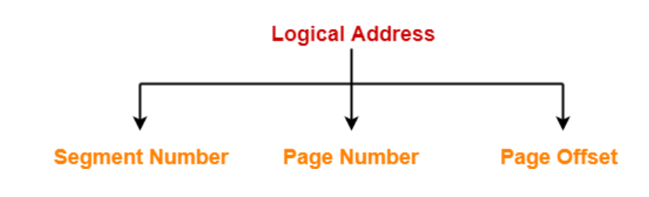
Segmented Paging
Segment Number specifies the specific segment from which CPU wants to reads the data.
Page Number specifies the specific page of that segment from which CPU wants to read the data.
Page Offset specifies the specific word on that page that CPU wants to read.

Slide 48
Segmented Paging
Step-02:
For the generated segment number, corresponding entry is located in the segment table.
Segment table provides the frame number of the frame storing the page table of the referred segment.
The frame containing the page table is located.
Step-03:
For the generated page number, corresponding entry is located in the page table.
Page table provides the frame number of the frame storing the required page of the referred segment.
The frame containing the required page is located.

Slide 49
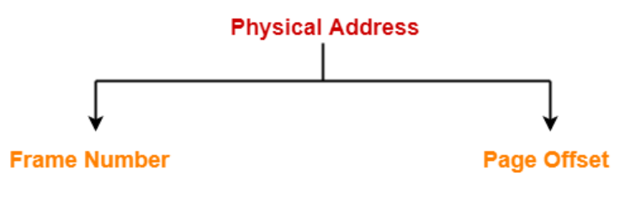
Segmented Paging
Step-04:
The frame number combined with the page offset forms the required physical address.
For the generated page offset, corresponding word is located in the page and read.

Slide 50
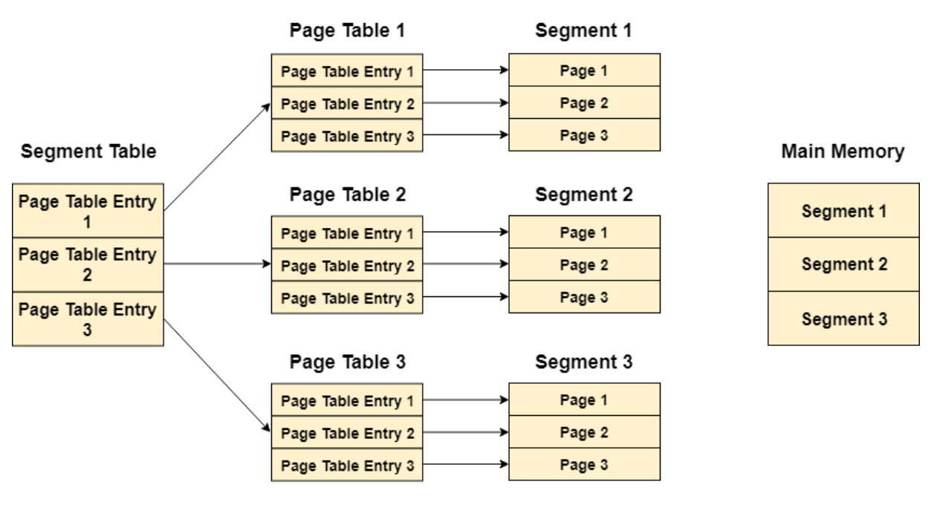
Segmented Paging

Slide 51
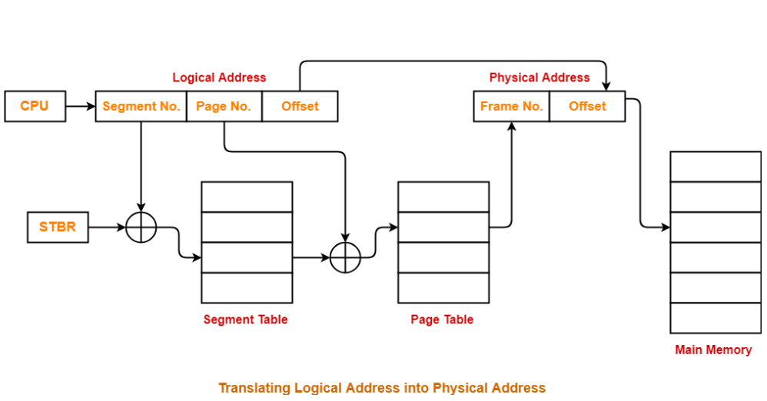
Segmented Paging

Slide 52
Segmented Paging
Advantages-
The advantages of segmented paging are-
Segment table contains only one entry corresponding to each segment.
It reduces memory usage.
The size of page table is limited by the segment size.
It solves the problem of external fragmentation.
Disadvantages-
The disadvantages of segmented paging are-
Segmented paging suffers from internal fragmentation.
The complexity level is much higher as compared to paging.

Slide 53
File Concept:
A file is a named collection of related information that is recorded on secondary storage.
File Structure
A file has a certain defined structure which depends on its types:
A text file is a sequence of characters organized into lines.
A source file is a sequence of subroutines and function.
An object file is a sequence of bytes organized into blocks understandable by the system’s linker.
An executable file is a series of code sections that the loader can bring into memory and execute.

Slide 54
File Attributes
Name – only information kept in human-readable form
Identifier – unique tag (number) identifies file within file system
Type – needed for systems that support different types
Location – pointer to file location on device
Size – current file size
Protection – controls who can do reading, writing, executing
Time, date, and user identification – data for protection, security, and usage monitoring
Information about files are kept in the directory structure, which is maintained on the disk

Slide 55
File Operations
The operating system provides system calls to create, write, read, reposition, delete, and
truncate files.
Creating a file.
Writing a file.
Reading a file
Repositioning within a file
Deleting a file
Truncating a file

Slide 56
File Access Method
File access mechanism refers to the manner in which the records of a file may be accessed. There are several ways to access files −
Sequential access
Direct/Random access
Indexed sequential access

Slide 57
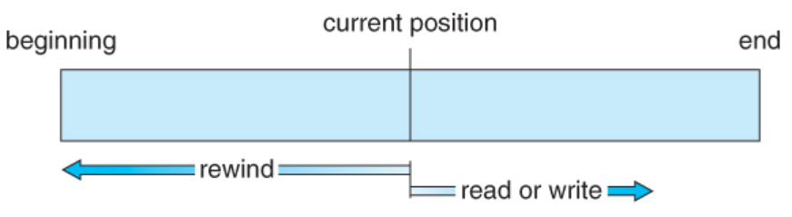
File Access Method
Sequential access
A sequential access is that in which the records are accessed in some sequence, i.e., the information in the file is processed in order, one record after the other.
read next - read a record and advance the tape to the next position.
write next - write a record and advance the tape to the next position.
rewind

Slide 58
File Access Method
Direct/Random access
Random access file organization provides, accessing the records directly.
Each record has its own address on the file with by the help of which it can be directly accessed for reading or writing.
The records need not be in any sequence within the file and they need not be in adjacent locations on the storage medium.

Slide 59
File Access Method
Indexed sequential access
This mechanism is built up on base of sequential access.
An index is created for each file which contains pointers to various blocks.
Index is searched sequentially and its pointer is used to access the file directly.

Slide 60
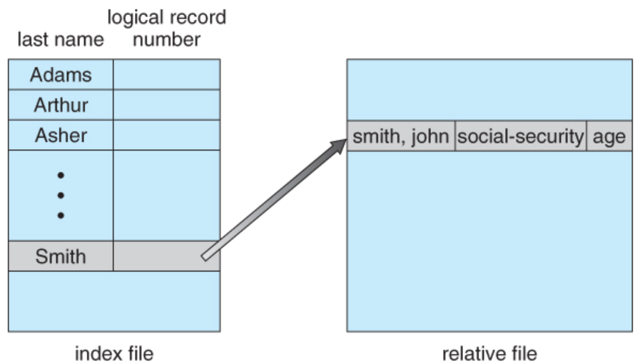
File Access Method-Index Method

Slide 61
Directory Structure
A directory is a container that is used to contain folders and file. It organizes files and folders into a hierarchical manner.

Slide 62
Directory Structure
Efficiency – locating a file quickly.
Naming – convenient to users.
Two users can have same name for different files.
The same file can have several different names.
Grouping – logical grouping of files by properties, (e.g., all Pascal programs, all games, …)

Slide 63
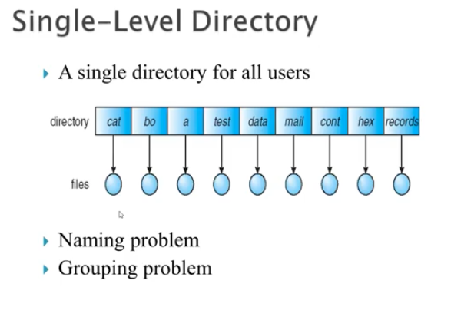
Directory Structure

Slide 64
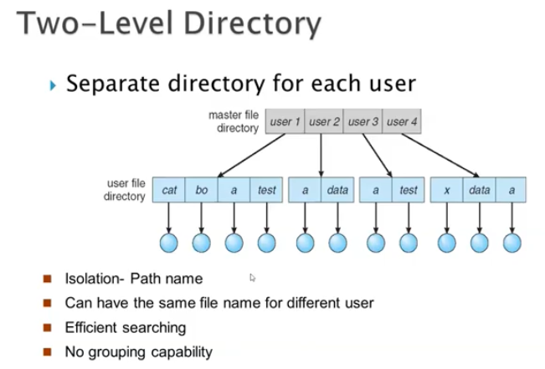
Directory Structure

Slide 65
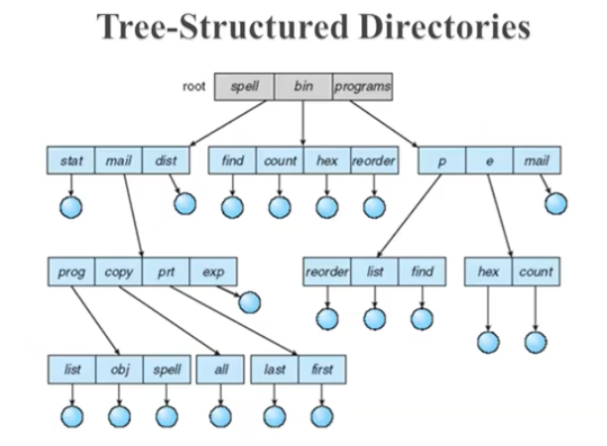
Directory Structure

Slide 66
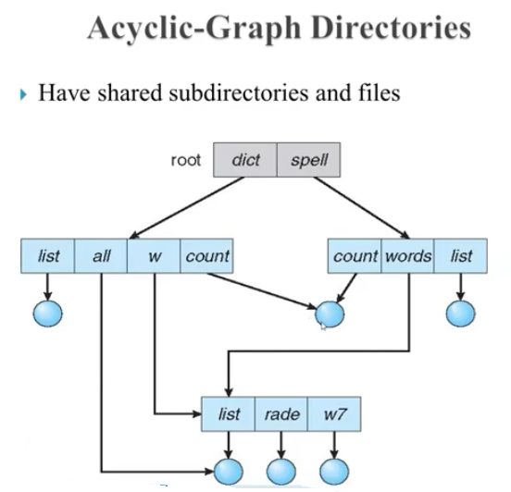
Directory Structure

Slide 67
Allocation Methods
An allocation method refers to how disk blocks are allocated for files:
Contiguous allocation
Linked allocation
Indexed allocation

Slide 68
Contiguous allocation
An allocation method refers to how disk blocks are allocated for files:
Contiguous allocation
Linked allocation
Indexed allocation

Slide 69
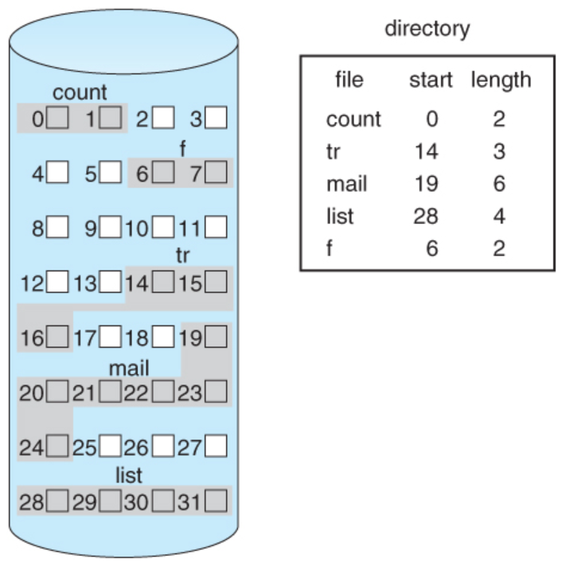
Contiguous allocation
It requires that all blocks of a file be kept together contiguously.
Performance is very fast, because reading successive blocks of the same file generally requires no movement of the disk heads, or at most one small step to the next adjacent cylinder.

Slide 70
Contiguous allocation
Drawback:
Problems can arise when files grow, or if the exact size of a file is unknown at creation time:
Over-estimation of the file's final size increases external fragmentation and wastes disk space.
Under-estimation may require that a file be moved or a process aborted if the file grows beyond its originally allocated space.
If a file grows slowly over a long time period and the total final space must be allocated initially, then a lot of space becomes unusable before the file fills the space.

Slide 71
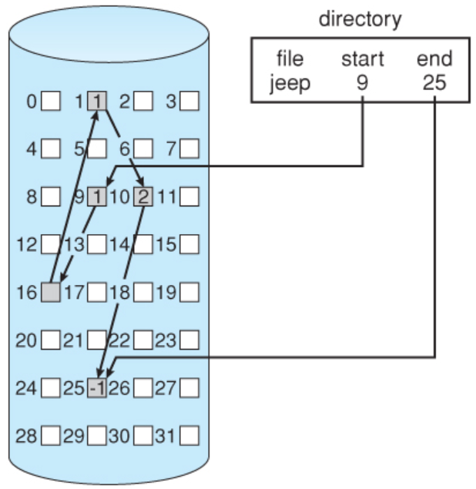
Linked allocation
Disk files can be stored as linked lists, with the expense of the storage space consumed by each link.
Linked allocation involves no external fragmentation, does not require pre-known file sizes, and allows files to grow dynamically at any time.

Slide 72
Linked allocation
Drawback:
Unfortunately linked allocation is only efficient for sequential access files.
Another big problem with linked allocation is reliability if a pointer is lost or damaged. Doubly linked lists provide some protection, at the cost of additional overhead and wasted space.

Slide 73
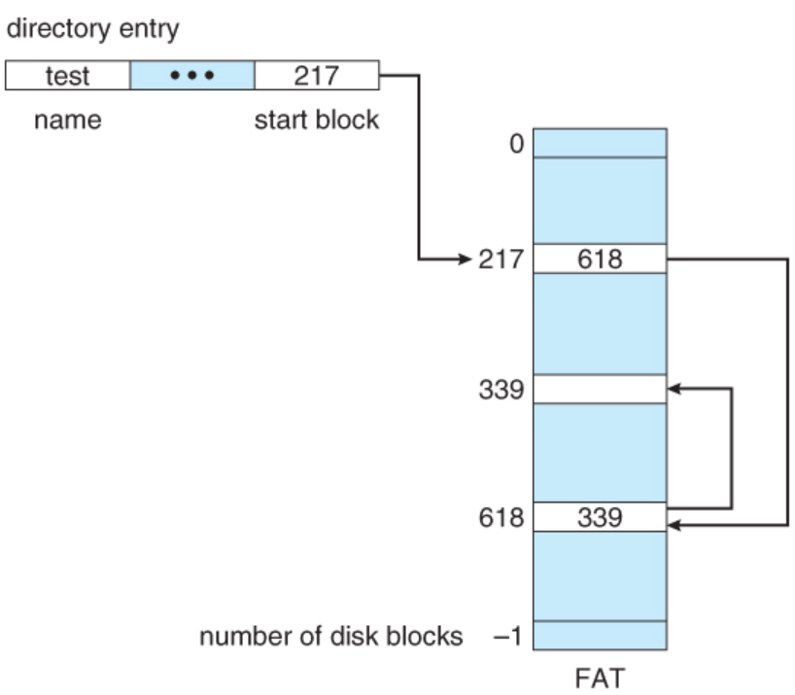
Linked allocation
File Allocation Table
FAT, used by DOS is a variation of linked allocation, where all the links are stored in a separate table at the beginning of the disk.
The benefit of this approach is that the FAT table can be cached in memory, greatly improving random access speeds.

Slide 74
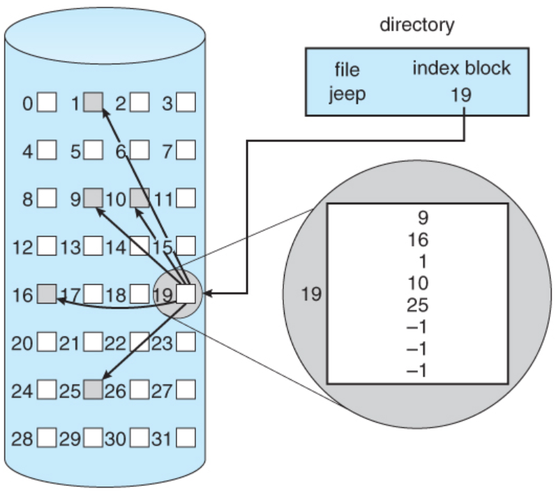
Indexed allocation
It combines all of the indexes for accessing each file into a common block ( for that file ), as opposed to spreading them all over the disk or storing them in a FAT table.

Slide 75
Indexed allocation
Drawback:
Some disk space is wasted ( relative to linked lists or FAT tables ) because an entire index block must be allocated for each file, regardless of how many data blocks the file contains.
This leads to questions of how big the index block should be, and how it should be implemented.
Multi-Level Index - The first index block contains a set of pointers to secondary index blocks, which in turn contain pointers to the actual data blocks.

Slide 76
File Sharing
Multiple Users
On a multi-user system, more information needs to be stored for each file:The owner ( user ) who owns the file, and who can control its access.
The group of other user IDs that may have some special access to the file.
What access rights are afforded to the owner ( User ), the Group, and to the rest of the world ( the universe, a.k.a. Others. )
Some systems have more complicated access control, allowing or denying specific accesses to specifically named users or groups.

Slide 77
Consistency Semantics
Consistency Semantics deals with the consistency between the views of shared files on a networked system. When one user changes the file, when do other users see the changes?
The UNIX file system uses the following semantics: Writes to an open file are immediately visible to any other user who has the file open.
One implementation uses a shared location pointer, which is adjusted for all sharing users.
The Andrew File System, AFS uses the following semantics: Writes to an open file are not immediately visible to other users.
When a file is closed, any changes made become available only to users who open the file at a later time.

Slide 78
File Protection
Files must be kept safe for reliability ( against accidental damage ), and protection ( against deliberate malicious access. ) The former is usually managed with backup copies. This section discusses the latter.
One simple protection scheme is to remove all access to a file. However this makes the file unusable, so some sort of controlled access must be arranged.

Slide 79
File Protection
Types of Access
The following low-level operations are often controlled:
Read - View the contents of the file
Write - Change the contents of the file.
Execute - Load the file onto the CPU and follow the instructions contained therein.
Append - Add to the end of an existing file.
Delete - Remove a file from the system.
List -View the name and other attributes of files on the system.
Higher-level operations, such as copy, can generally be performed through combinations of the above.

Slide 80
File Protection
Access Control
One approach is to have complicated Access Control Lists, ACL, which specify exactly what access is allowed or denied for specific users or groups.
UNIX uses a set of 9 access control bits, in three groups of three. These correspond to R, W, and X permissions for each of the Owner, Group, and Others.

Slide 81
File Protection
Other Protection Approaches and Issues
Some systems can apply passwords, either to individual files, or to specific sub-directories, or to the entire system. There is a trade-off between the number of passwords that must be maintained ( and remembered by the users ) and the amount of information that is vulnerable to a lost or forgotten password.
Older systems which did not originally have multi-user file access permissions ( DOS and older versions of Mac ) must now be retrofitted if they are to share files on a network.
Access to a file requires access to all the files along its path as well. In a cyclic directory structure, users may have different access to the same file accessed through different paths.

Slide 82
File Protection
Mode of access: read, write, execute
Three classes of users
a) owner access RWX ⇒ 1 1 1
b) groups access RWX ⇒ 1 1 0
c) public access RWX ⇒ 0 0 1
Ask manager to create a group (unique name), say G, and add some users to the group.
For a particular file (say game) or subdirectory, define an appropriate access.

